Slide 1
Omega Alpha Academy 2020-2021: Reopening Contingency Plan
One School, One Goal!
August 5, 2020

Slide 2
School Reopening Plan: Table of Contents
Omega Alpha Academy: Vision and Mission Statement
Letter from the Superintendent
Reopening Plan
Long-Term Goals
Safety and Wellness
School Day
School Calendar
Transportation

Slide 3
Omega Alpha Academy: One School, One Goal
Our Vision
Our Mission
The vision of OAA is that all students will be equipped for college and careers by meeting or exceeding the given standards.
The mission of Omega Alpha Academy is to prepare students for college and career readiness by engaging every student in a rigorous learning environment. The annual assessment test, such as the Galileo, will be measured by showing an increase of three percent on overall performance growth.

Slide 4
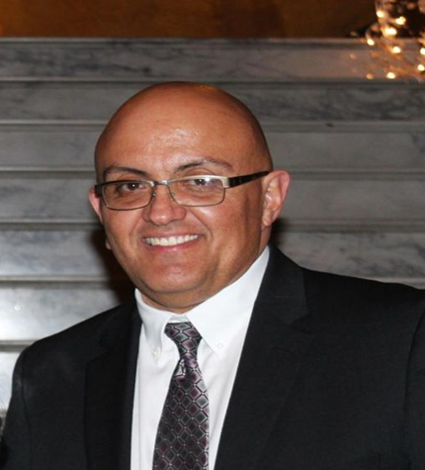
Omega Alpha Academy Superintendent: Mr. Jose A. Frisby
Dear Omega Alpha Academy Family,
I am eager to share with you the Omega Alpha Academy Reopening Plan for the 2020-2021 School Year.
The health and well-being of our students, faculty, and staff has always been paramount. We have developed this plan using guidance and recommendations from local and state health officials, as well as the Arizona Department of Education. We will be implementing rigorous protocols and high standards to minimize risks associated with COVID-19. These protocols will be interwoven throughout every phase of our school operations. The standards and procedures outlined in our plan will be continuously monitored and updated.
Our goal is to simply to provide the best possible instruction the safest way possible. We understand that significant risk factors will play a critical role the success of our plan but please know that we will continue to follow the latest CDC recommendations. We invite you to please take the time to review and familiarize yourselves with our Reopening Plan.
We will continue to provide updates and guidance, as they become available.
Respectfully,
Jose A. Frisby
Executive Director/Principal
520-368-7628
jfrisby@oaak12.org

Slide 5
Omega Alpha Academy: Reopening Contingency Plan
Omega Alpha Academy, in partnership with the Arizona Department of Education, Arizona State Board for Charter Schools, AZ Governor Doug Ducey, AZ Public Health Services, and federal, state, and local officials has developed requirements and recommendations to support schools in determining plans and strategies for reopening. Omega Alpha Academy’s Reopening Plan provides a multi-tiered approach with clear, actionable steps that are applicable throughout the 2020-2021 school year.
This plan is built upon the guidance and recommendations of the CDC, local, and state health officials; it is strongly aligned to the reopening guidelines that have been provided by our state and federal leaders, and it is designed to help our school prioritize the health and safety of students and teachers as we open our school building and deliver instruction for this upcoming academic year.
The Omega Alpha Academy Reopening Plan focuses heavily on the health and physical requirements necessary for the reopening of our campus. OAA will continue to provide guidance and recommendations to staff and parents as we continue to navigate through the ever changing effects of the COVID-19 pandemic.

Slide 6
Omega Alpha Academy: Reopening Contingency Plan
OAA will continue to provide guidance and recommendations to staff, parents, and the general community as we continue to navigate through the ever changing effects of the COVID-19 pandemic.

Slide 7
Omega Alpha Academy: Reopening Contingency Plan
Please be advised this contingency plan is highly fluid.
It is subject to change in conjunct with the latest guidelines/procedural changes.

Slide 8
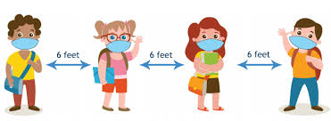
Omega Alpha Academy: Welcome Back

Slide 9
Omega Alpha Academy: Long-Term Goals
Increase our overall academic score by 3%
Ensure High School Readiness, in regards to academics & COVID-19 Preparedness
Omega wants to be known as a STEM School

Slide 10
Next Steps
In the spring, the goal was to provide flexibility and rigorous instruction model as our school, community and families learned how to navigate through the COVID-19 crisis.
Activities for social/emotional learning will be provided to assist in building community in a distance learning environment.
Support for student wellness will include mental and health services whenever necessary.

Slide 11
Omega Alpha Academy: Parent, Staff & Student Guidelines for Reopening of School
Implementation (of CDC guidance) should be guided by what is feasible, practical, acceptable, and tailored to the needs of each community.
The following guidelines will help provide K-12 school administrators, parents, teachers, and staff with strategies to help ensure the safety and well-being of all the Omega Alpha Academy Family.

Slide 12
Omega Alpha Academy School Calendar
The Omega Alpha Academy Governing Board voted to change the start date for the
2020/2021 school year to August 10, 2020.
Schools will start online on August 10, 2020.
On campus (physically present) learning will begin on October 5, 2020.
(This date may change.)
The following calendar has been approved by our school Governing Board.

Slide 14
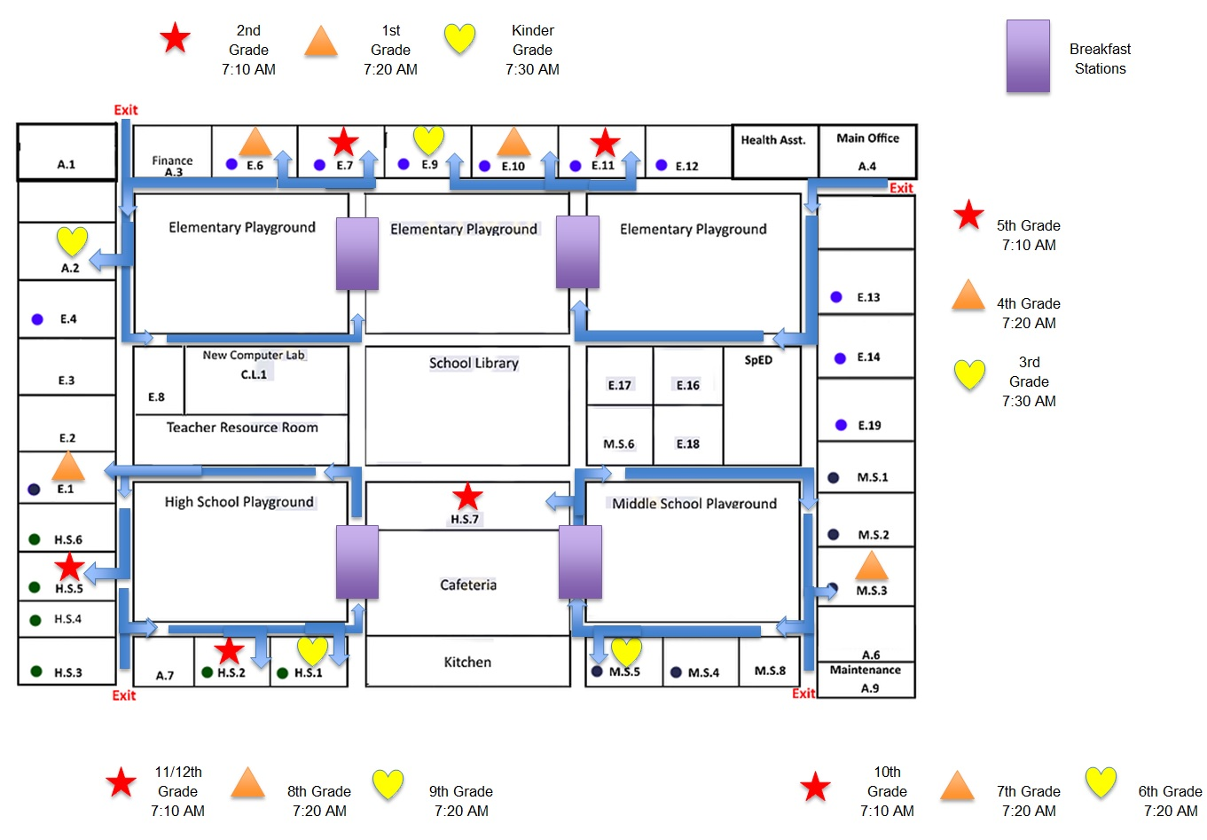

Slide 15
How and When Will We Transition Back to Traditional Teaching?
Omega Alpha Academy will transition back to its traditional teaching platform as soon as it is deemed safe by the CDC and state and local health officials.
When Omega Alpha Academy’s campus is reopened: students and parents have the option of remaining enrolled in Distancing Learning.

Slide 16
Educational Opportunities
Starting August 17, 2020; Omega Alpha Academy will provide
on-site learning opportunities and support services for students kindergarten through the 12th grade who need a safe place to go.
*Those students attending on-site will be participating in our online synchronous instruction program.

Slide 17
Tentative Traditional Campus Reopening Date (Physically Present)
October 5, 2020

Slide 18
Clarification from Superintendent Kathy Hoffman
Full funding for distance learning, for schools and families that decide this is the safest instructional model.
Requirements for the Arizona Department of Health Services (ADHS) to develop, by August 7th, public health metrics for schools to use to determine a safe return to in-person instruction (additional information below).
Statewide mandate for face coverings in schools for both students and staff
Clarity around the intention of the on-site support services requirement, as well as a waiver process for this requirement.

Slide 19
Educational Options
Omega Alpha Academy parents/guardians will be asked to make the choice that best meets their own circumstances.
Omega Alpha Academy has multiple options from which parents can choose.
Option 1: Students will be attending online instruction as they did during the second half of semester two ( From March 2020 to May 2020) or during the summer.
Option 2: Students can attend in-person instruction.
Option 3: Students may attend a hybrid model.

Slide 20
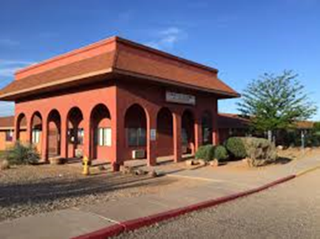
Educational Options
On Campus Learning
Kindergarten-5th
6th-8th Grades
9th – 12th Grades
Full-time Online Synchronous Learning
Kindergarten-5th
6th-8th Grades
9th – 12th Grades
Hybrid Learning
Kindergarten-5th
6th-8th Grades
9th – 12th Grades

Slide 21
What is Distance/Online Learning?
Distance learning, also called distance education, e-learning, and online learning, form of education in which the main elements include physical separation of teachers and students during instruction and the use of various technologies to facilitate student-teacher and student-student communication.

Slide 22
What is Distance/Synchronous Online Learning?
No in-person teacher led instruction
Teacher led lessons via Google Meets
Students are enrolled in all content areas
Engaging and synchronous online lessons created and taught aligned to state standards
Grades will be issued
Attendance is mandatory

Slide 23
What is Distance/Synchronous Online Learning?
Continued access to services that support all learners including but not limited to:
Special Educations Students
English Language Learners
Counseling
Health Office Support
Food & Nutrition Services
School schedule:
Elementary: Monday- Friday from 8:00 am to 2:30 pm
Middle/High School: Monday-Friday from 7:40 am to 2:30 pm
180 instructional days

Slide 24
Synchronous Online Learning at OAA
Action Step(s) | Person(s) Responsible | Frequency and/or Timing | Evidence of Implementation
Student participation in a virtual or classroom session (Google Meets). | Each individual teacher will submit their classroom attendance to the school registrar. | Elementary-twice a day one for am session and second for pm session. Middle and high school will be at the commencement of every period (6). | Meet Attendance through Google Meets.

Slide 25
Distance Learning Expectations: Teacher/Staff General Expectations
Action Step(s) | Person(s) Responsible | Frequency and/or Timing | Evidence of Implementation
Teachers are expected to provide synchronous virtual lessons daily for every period; all lessons will be recorded in its entirety. This is what was utilized for the 4th quarter mandated school closure SY 2019-2020. Teachers are expected to teach five days of the week for the normal duration of the regular class. | Each individual teacher is responsible for the daily lesson The school principal will ensure the implementation of this action. | Daily: Monday-Friday for every class period. | Lesson plan submissions Lesson Plan Exemplars Daily classroom recordings from beginning to end Verification on the part of the Resource and Development Team (RDT) through individual classroom analysis notes School principal verification through individual classroom analysis notes

Slide 26
Distance Learning Expectations Student Attendance:
● Teachers will take attendance through Google Meets at the beginning of each class period or twice a day (am and pm) for elementary grades.
● If a student is absent, teachers will mark the student “A” in PowerSchool.
● If a student is tardy, teachers will mark the student “T” in PowerSchool.
○ Students will log in to each class ON TIME; a late log-in is still a tardy tracked in PowerSchool.
● Students will attend assigned classes every day that school is in session during the scheduled time.
● During class, students will adhere to the Omega Alpha Academy-Student Code of Conduct.

Slide 27
Demonstrating Mastery of Academic Content
Action Step(s) | Person(s) Responsible | Frequency and/or Timing | Evidence of Implementation
Careful thought and creativity goes into lesson planning and exemplar creating. DOK level questioning is strategically scaffolded and assessed via quizzes, tests, cold calling, verbal and written summarizations. Students are continuously monitored throughout the lesson to check for comprehension and mastery of the standard. | General Education Teachers Testing Coordinator Principal | Throughout the lesson Daily Weekly Every Six Weeks (Galileo) | Student Grades Test Results Student Data Homework Samples Assignments/Projects Verbal confirmation during the cold calling process

Slide 28
Professional Development
PD Plan for teachers started on July 27, 2020.

Slide 29
Professional Development
Action Step(s) | Person(s) Responsible | Frequency and/or Timing | Evidence of Implementation
Professional Development is conducted as a whole-group this includes instructional and support personnel. Professional Development is tailored off of classroom observation data. OAA has retained the services of retired ADE School Improvement Specialist, Dr. Arnie Adler to provide recommendations. Every virtual lesson is recorded and meticulously analyzed with all instructional staff in group settings to provide recommendations to increase student engagement and improve instruction. Upon teacher request administration avails itself for individualized professional development opportunities. School Admin has created a detailed Professional Development plan which not only identifies the date but the topic as well. | Resource and Development Team School Principal Retired ADE School Improvement Specialist consultant | Weekly (already planned) As needed Upon Teacher Request | Meeting Agendas Sign-In Sheets Meeting Notes Recordings of the training Teacher Surveys

Slide 30
Tentative: Professional Development Calendar

Slide 31
Professional Development Topics
List Specific Professional Development Topics That Will Be Covered
Lesson Plan Creation and Implementation Methodologies Scaffolding Formative Assessments Classroom Management Strategies Close Reading Breaking Down (Unpacking) the Standards Using Data to Drive Instruction Curricular Mapping Gap Analysis Chunking and Aligning the Standard Revising Existing Lesson Plans to Address Student Needs.

Slide 32
Specialized Instruction and IEP Services
Action Step | Person(s) Responsible | Frequency and/or Timing | Evidence of Implementation
Special Education Students will be provided individualized instructional support specifically listed on their IEPs through online sessions with Special Education Teacher and/or Special Education Paraprofessional. Special Education Teacher will work in conjunction with the student’s general education teacher to assist in providing necessary accommodations during online instruction. All classroom lessons delivered through Google Meets are recorded and easily accessible to Special Education students for further review. Related services will be provided via Web-Therapy. | Special Education Teacher Special Education Paraprofessional Related Service Providers Principal | Frequent/daily communication and feedback among all IEP Team members. IEP services will be provided daily or according to each individual student IEP. | Communication Logs IEP Service Minute Log Classroom Recordings

Slide 33
Specialized Instruction and IEP Services
Process for Implementing Action Step
Create Special Education Schedule Review IEPs with general education teachers Communicate frequently with IEP Team Members Record all services/lessons, and keep proper documentation

Slide 34
Providing Services for EL Students
Action Step | Person(s) Responsible | Frequency and/or Timing | Evidence of Implementation
Omega Alpha Academy will follow all approved researched-based ADE recommended SEI models for the 2020-2021 school year. Omega Alpha Academy will adhere to all AZELLA testing guidelines. Omega Alpha Academy will incorporate depictions, visuals, videos, etc. to help enhance lessons and further clarify specific standards for our EL students. | EL Coordinator General Education Teachers Principal | Daily Testing (Placement Test-Beginning of school year or as needed and Reassessment Tests towards the end of the school year). | Lesson Plan Submission Classroom Recordings Testing Data

Slide 35
Providing Services for EL Students
Process for Implementing Action Step
Attend all ADE- AZELLA/EL Trainings, implement SEI Models in our classrooms, address EL needs through various forms of instructions to help address EL standards, monitor lesson plan submissions, and provide support to teachers through professional development.

Slide 36
Technology
Computing Devices & Connectivity
To the extent possible, Omega Alpha Academy will provide students with individual computers or tablets with accessories sufficient to participate in video classrooms .
Technology devices will be available while supplies last.
Parents must submit request forms or email Mr. Frisby at jfrisby@oaak12.org
We are hoping to provide devices to as many students as possible.
Person responsible for issuing technology devices:
Mr. Paul Hartman (phartman@oaak12.org)

Slide 37
Safety and Wellness
We are opening schools with three different choices for parents so families can make the best decisions for their circumstances.
One option is On Campus Learning. The following procedures are under consideration to enhance safety for all students and staff while physically at school.
We will continue to make changes to these procedures as circumstances dictate.

Slide 38
Safety and Wellness
Daily home health screening – PLEASE DO NOT COME TO SCHOOL SICK.
Please run this wellness checklist EVERY day before sending your student to school.
Staff will be observing students for signs of illness.

Slide 39
Safety and Wellness
Please keep children home if they are experiencing any of the following symptoms:
Fever of 100.4 or higher
Cough
Shortness of breath or difficulty breathing
Fatigue
Muscle or body aches
Headaches
New loss of taste or smell
Sore throat
Congestion or runny nose
Vomiting
Diarrhea

Slide 40
Health Aid
Omega Alpha Academy will designate a specific space as a “sick” room.
Students who are displaying symptoms of any flu, cold, respiratory type illness will use this room instead of the health office.

Slide 41
Personal Health and Wellness Tips
Hand Washing
Sites will be implementing hand washing protocols.
Additional hand washing will be expected at all sites.
Face Touching
Schools will provide education and reminders that when one touches an infected surface with his/her hand and then touches eyes, nose, or mouth — which are entryways for viruses into the body — one could potentially become infected and get sick.

Slide 42
Face Coverings
There is a Cochise County Resolution requiring face coverings in all settings where social distancing may not be possible.
Absent this requirement in the future, it is our intent to do the following:
Create a cultural norm that adults and students will wear face coverings when physical distancing is not possible.
Ask that parents provide a face covering for their student.
If a student comes to school without a face covering, one will be provided.

Slide 43
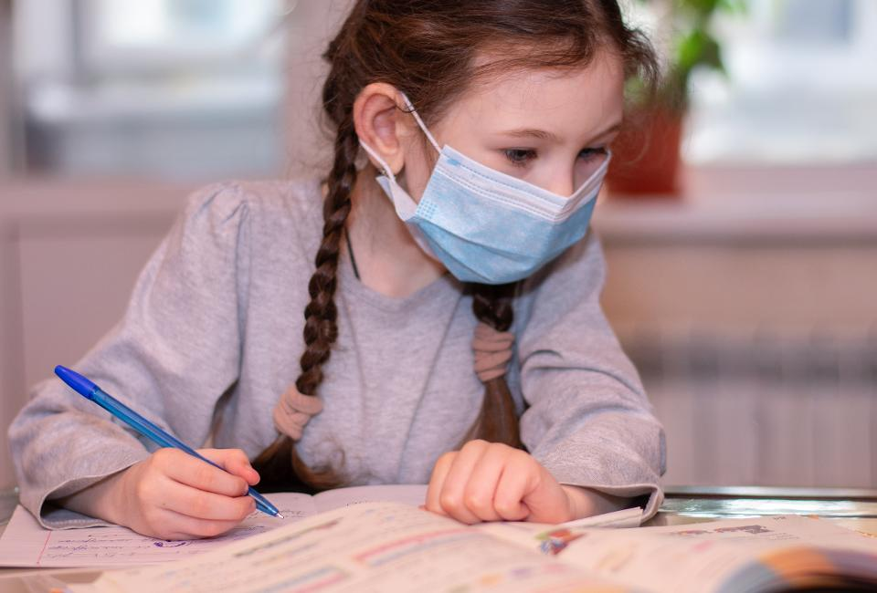
Facemask
Use of Cloth Face Coverings in Schools (K-12th)
COVID-19 can be spread to others even if you do not feel sick.
A cloth face covering helps prevent a person who is sick from spreading the virus to others.
CDC suggests that all school reopening plans address adherence to behaviors that prevent the spread of COVID-19.
When used consistently and correctly, cloth face coverings are important to help slow the spread of COVID-19.

Slide 44
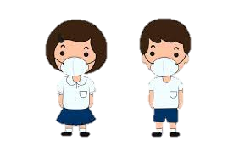
Facemask
Cloth face coverings should not be placed on:
Children younger than 2 years old.
Anyone who has trouble breathing or is unconscious.
Anyone who is incapacitated or otherwise unable to remove the cloth face covering without assistance.
Appropriate and consistent use of cloth face coverings may be challenging for some students, teachers, and staff, including:
Younger students, such as those in early elementary school.
Students, teachers, and staff with severe asthma or other breathing difficulties.
Students, teachers, and staff with special educational or healthcare needs, including intellectual and developmental disabilities, mental health conditions, and sensory concerns or tactile sensitivity.

Slide 45
Precautionary Measures
Building Sanitizing and Cleaning
*Sanitizing is a process to remove contaminants including germs and viruses.
*Cleaning is a process to remove residue including dirt, grime, waste, etc.
Sanitizing and cleaning will be done with frequency in all classrooms and expanded to include the following:
Sanitizing will occur in high frequency areas in regular intervals throughout the day.
Cleaning will occur daily.
Site and custodial staff are collaborating regarding site specific needs.

Slide 46
Restrooms
Cleaning will occur daily.

Slide 47
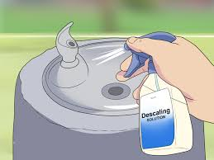
Drinking Fountains
Students will be encouraged to bring water bottles.
Drinking fountains will be utilized, modified, or closed based on site needs.
If drinking fountains are open, they will be sanitized at regular intervals throughout the day.

Slide 48
Playground
All playground structures will be closed.

Slide 49
Physical Distancing & Traffic Flows
Following CDC guidelines for schools, physical distancing will be done when feasible.
Students will be physically distanced to the greatest extent possible.
Six feet of physical distancing in classrooms may not be possible.
Sites will institute traffic patterns that maximize physical distancing.

Slide 50
Ventilation
Ensure ventilation systems operate properly and increase circulation of outdoor air as much as possible, for example by opening windows and doors.
Do not open windows and doors if doing so poses a safety or health risk (i.e., risk of falling, triggering asthma symptoms) to children using the facility.

Slide 51
Visitors
At this time, only approved Omega Alpha Academy faculty and staff will be allowed to be present in the classroom.
All visitors are discouraged, due to COVID-19 restrictions, from entering classrooms or school premises.

Slide 52
Challenges with Wellness
In order for schools to operate in a traditional platform this year, screening for symptoms and history of exposure will be very important.
For students attending Omega Alpha academy, there is a continuum where wellness will be checked.

Slide 53
Addressing COVID-19 Spread in Omega Alpha Academy
Levels of Safety measures

Slide 54
Challenges with Wellness
Home: is the first point on the screening continuum and therefore, the most important.
Transportation
School
LEAs should educate and support families on identifying the symptoms that indicate staff and students must stay at home.
Families should be encouraged to self-report symptoms of illness, which could include fever, new onset of cough, etc.
Self-reporting mechanisms could include calling the school, calling health-care provider, etc. .
TRANSPORTATION is the second point on the screening continuum.
LEAs should use clearly visible signage to communicate the symptoms students should not have if traveling on a school bus.
SCHOOL is the final point on the screening continuum.
LEA staff should visually/technologically check for symptoms (which may include temperature checks) and/or confirm with families that students are COVID-19 symptom free.
*Follow up with healthcare professional.

Slide 55
How should OAA prepare for, and respond to, COVID-19?
When a confirmed case has entered a school, regardless of community transmission
any school in any community might need to implement short-term closure procedures regardless of community spread if an infected person has been in a school building. If this happens, CDC recommends the following procedures regardless of the level of community spread:
Coordinate with local health officials. Once learning of a COVID-19 case in someone who has been in the school, immediately notify local health officials. These officials will help administrators determine a course of action for their child care programs or schools.

Slide 56
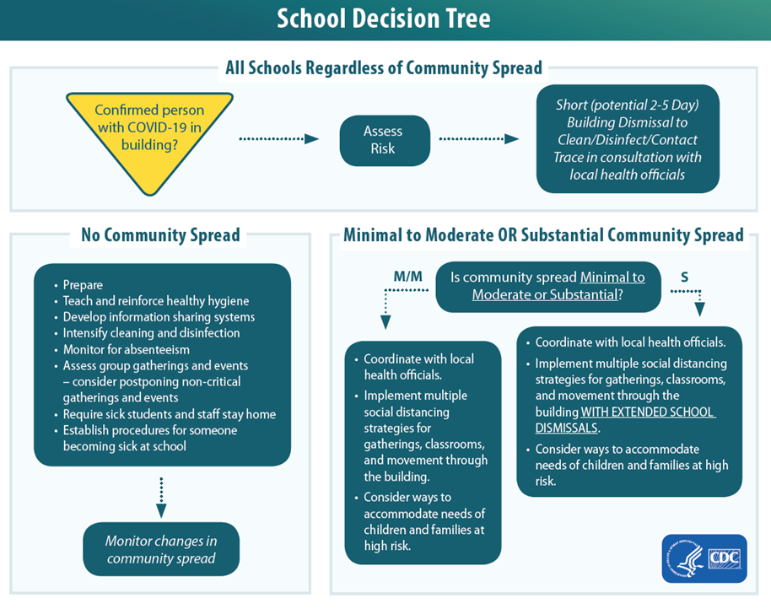

Slide 57
How should OAA prepare for, and respond to, COVID-19?
Local health officials’ recommendations for the scope (e.g., a single school, multiple schools, the full district) and duration of school dismissals will be made on a case-by-case basis using the most up-to-date information about COVID-19 and the specific cases in the community.

Slide 58
How should OAA prepare for, and respond to, COVID-19?
Discourage staff, students, and their families from gathering or socializing anywhere.
This includes group child care arrangements, as well as gathering at places like a friend’s house, a favorite restaurant, or the local shopping mall.

Slide 59
How should OAA prepare for, and respond to, COVID-19?
Communicate with staff, parents, and students. Coordinate with local health officials to communicate dismissal decisions and the possible COVID-19 exposure.

Slide 60
How should OAA prepare for, and respond to, COVID-19?
Clean and disinfect thoroughly.
Close off areas used by the individuals with COVID-19 and wait as long as practical before beginning cleaning and disinfection to minimize potential for exposure to respiratory droplets.
Open outside doors and windows to increase air circulation in the area. If possible, wait up to 24 hours before beginning cleaning and disinfection.

Slide 61
How should OAA prepare for, and respond to, COVID-19?
Clean and disinfect thoroughly.
Cleaning staff should clean and disinfect all areas (e.g., offices, bathrooms, and common areas) used by the ill persons, focusing especially on frequently touched surfaces.
If surfaces are dirty, they should be cleaned using a detergent or soap and water prior to disinfection.
Additional information on cleaning and disinfection of community facilities such as schools can be found on CDC’s website.

Slide 62
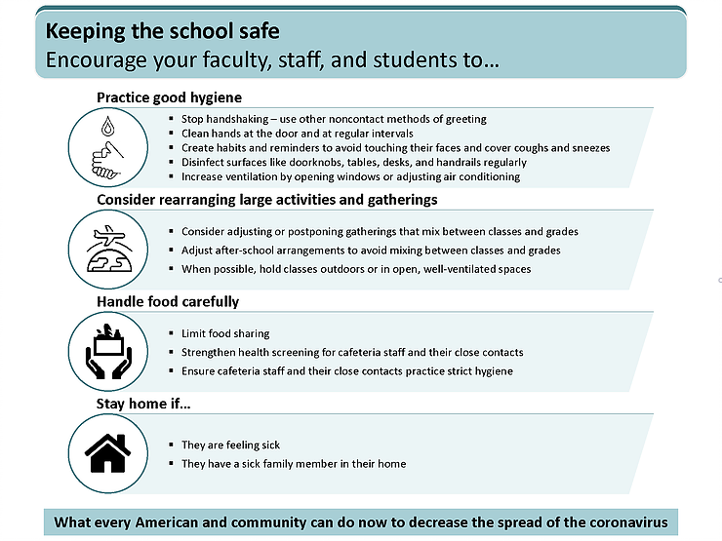

Slide 63
Transportation
● LEAs should also consider methods for physical distancing on buses, which could include assigned seating for riders, and the possibility of needing more buses or alternative schedules to safely transport students.

Slide 64
Transportation: Rules & Regulations
One student per seat on the bus, Skipping Rows
Students must wear a face mask covering
Follow same bus schedule (s) for am and pm
Student drop off and pick up procedures at each entrance to avoid congestion
Temperature checks/Screening upon arrival

Slide 65
PICK-UP AND DROP OFF
Morning Drop off
Students say goodbye to parents at the front gate and walk to our campus.
Students must follow all social distance markers located strategically on the ground.
Students will sanitize hands as they enter school premises using sanitizer provided.
Students must be wearing their facemasks.
Health assistant will be screening students before entering the school campus.

Slide 66
Pick-up and Drop-off Procedures
The principles that OAA follows for the morning drop-off and afternoon pick-up system are:
The safety of the children
Cooperation with the faculty
Consideration of, and politeness toward, our residential neighbors

Slide 67
Pick-up and Drop-off Procedures
The way in which we adhere to these principles is to follow, without exception, the directions listed below:
Do use the pick-up/drop-off lane system for all children in grades Kindergarten through 12th..
Do have your children gather their belongings together before they exit from your car. This keeps the pick-up/drop-off lane flowing smoothly.
Do pull all the way forward along the yellow curb as directed by the on-duty teachers.
Do use the crosswalk to bring your children on to campus if you walk to school or park your car on the street. It is extremely unsafe for any child to cross the street or parking lot alone.
Do respect our residential neighbors and refrain from blocking or turning in their driveways.

Slide 68
End of the Day Dismissal
Students Walking
Students Riding the Bus
Students in Cars
Students will be walked to the crosswalk and then be on their way. If they walk with a sibling, the older student will wait for the young sibling outside the entrance.
Bus riders will be escorted to the bus area. Students will get on the bus, follow safety protocols, and be on their way.
If you are picking up your child in a car you have two options:
Park and wait for your child
Use the car pickup or drop off lane
When in the car, please:
Stay in your car, do not get out
Get in the appropriate lane

Slide 69
BUS SCHEDULE
Coming Soon

Slide 70
Staggered Schedule
Stagger arrival and drop-off times or locations by grade to limit contact between grade levels and direct contact with parents as much as possible.

Slide 71
School Day
What will an average school day look like for your child?

Slide 72
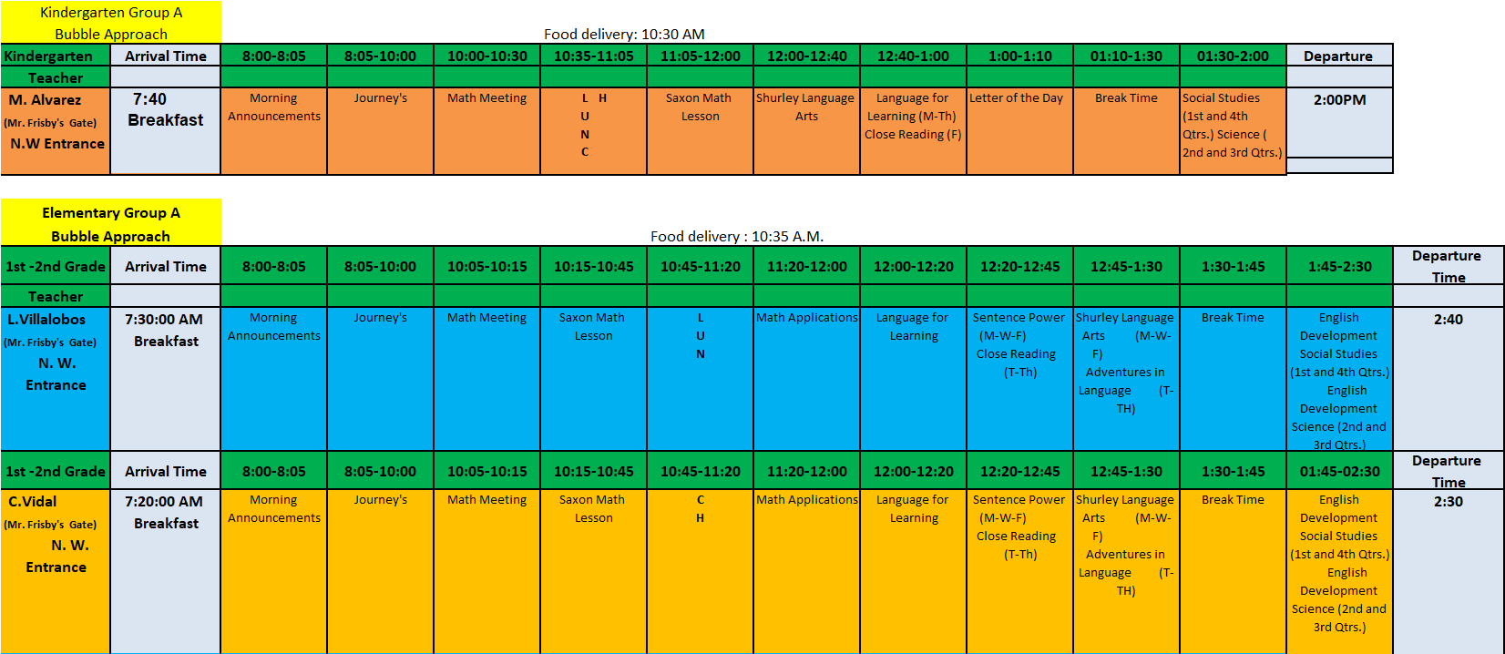
Kinder-2nd Grade

Slide 73
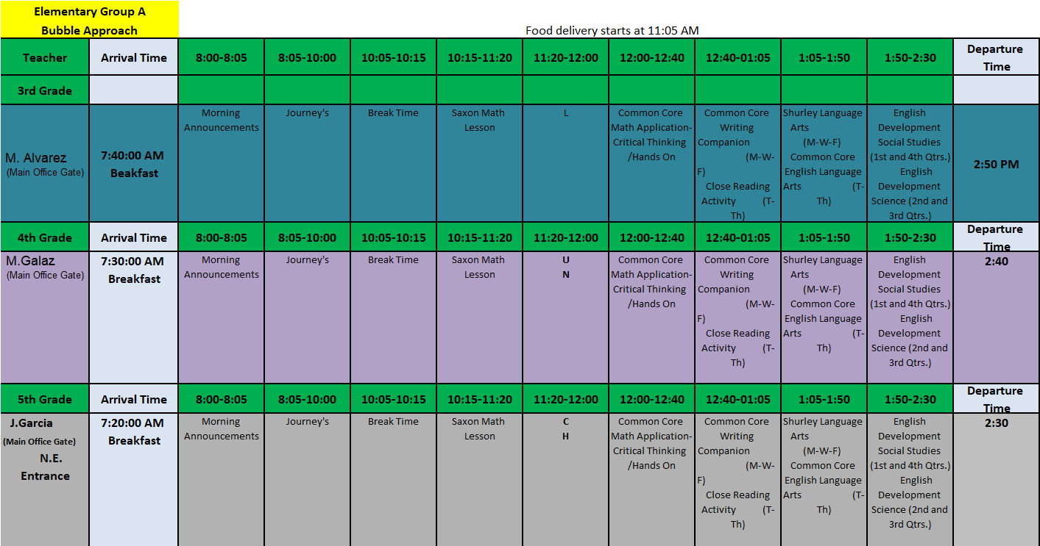
Elementary 3rd-5th

Slide 74
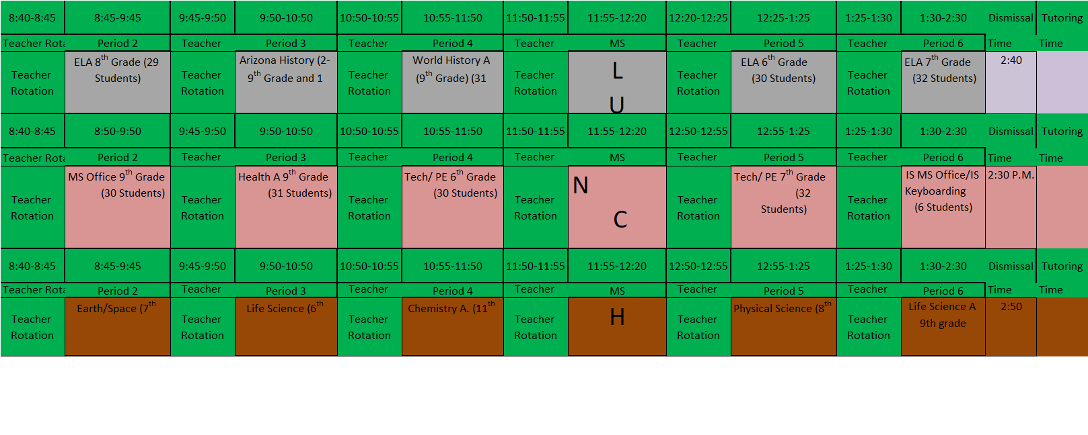
Middle School

Slide 75
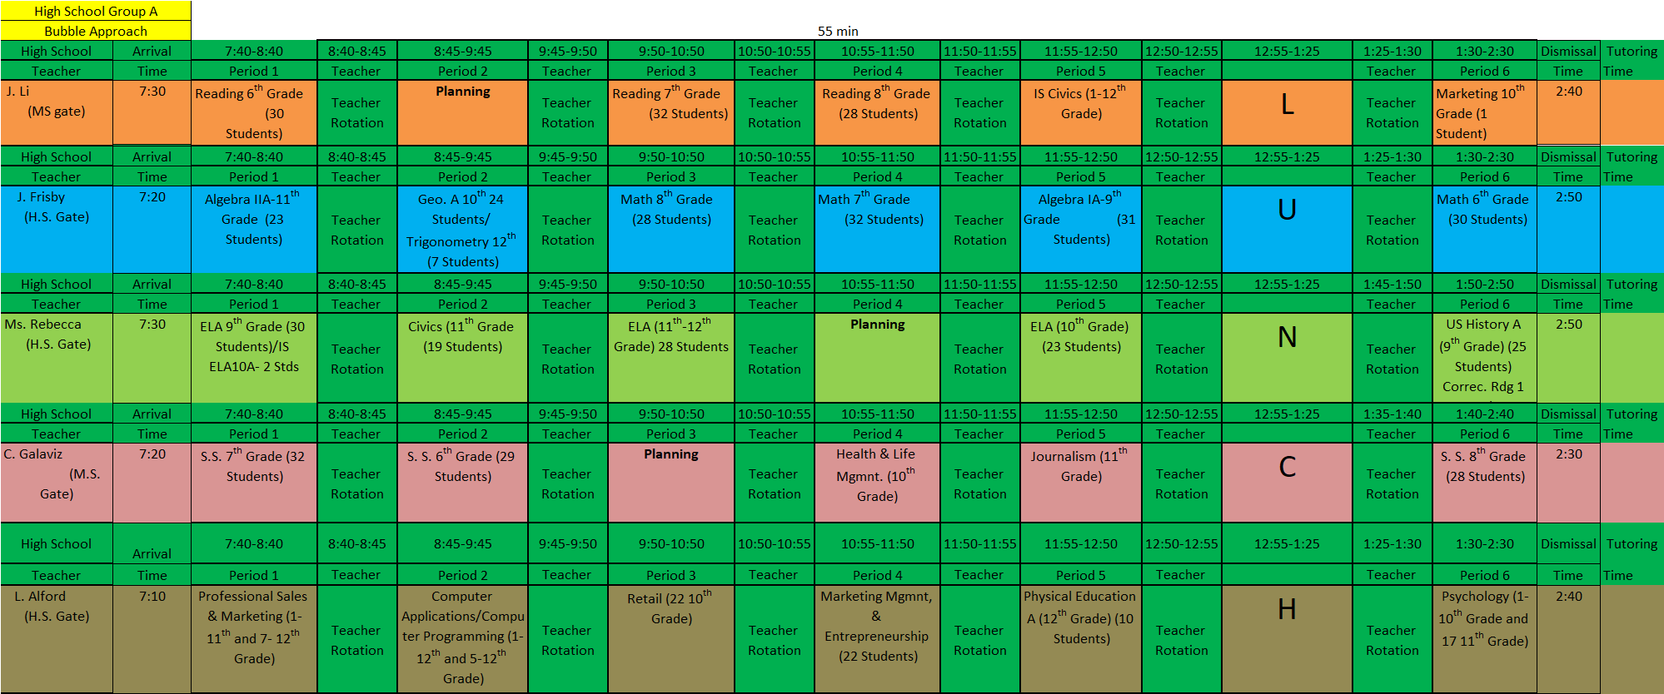
High School

Slide 76
Elementary/Middle School/High School Regulations
Arrival:
For the 20/21 school year, school hours will be
Elementary 8:00 am – 2:30 pm
MS/HS 7:40 am – 2:30 pm
Students will proceed directly to their first period class upon arrival until the school day begins at 7:40 am.
When students arrive they will enter through an assigned gate based on their grade level.
Gates will open at 7:10 am.

Slide 77
Elementary/Middle School/High School Regulations
Walkers will be allowed to enter the campus at their designated time and should arrive no earlier, please plan accordingly.
Students who are dropped off must wait in a vehicle until the gates open at 7:10 or later to allow for social distancing.

Slide 78
Elementary/Middle School/High School Regulations
In the Classroom:
Desks will be arranged in rows.
Backpacks will stay with students in the classroom to reduce travel within the room.
Hand sanitizers will be provided in all classrooms.
Students will use hand sanitizer as often as possible.
When feasible, students will be encouraged to wash hands in classrooms with available sinks.
Desks will be sanitized regularly.
Students will be given a supply list and will be required to bring their individual supplies everyday.
Shared supplies will not be permitted.

Slide 79
Elementary/Middle School/High School Regulations
Walkways and Transitions:
In walkways students will follow a counter-clockwise direction flow.
Large arrows and/or signage will be displayed for communication.
Students will not line up or congregate outside of classrooms.
Non-teaching staff will supervise students on restrooms breaks and walkway procedures.

Slide 80
Elementary/Middle School/High School Regulations
Lunches:
Students will attend lunch by grade level.
Students will eat lunch inside their classroom.
Identification card scanners will be utilized.
Cafeteria staff will bring students lunches to their respective classrooms.
Students will have 20 minutes to eat.

Slide 81
Middle School/High School Regulations
Specials:
Physical Education
Students will not be dressing out or using shared equipment.
STEM
Sharing of student supplies will be limited. Any resources that must be shared will be sanitized between any student use.

Slide 82
Physical Distancing
Physical Distancing Limiting the physical interactions of students is one way to mitigate exposure to infectious disease.
LEAs should consider their ability to physically distance students to the extent possible.

Slide 83
Modified Layouts
• Space seating/desks to allow for physical distancing (at least six feet apart when feasible).
• Assigned seating to help track virus spread if a student/staff tests positive for COVID-19.
• Turn desks to face in the same direction (rather than facing each other), or have students sit on only one side of tables, spaced apart.
• Create distance between children on school buses

Slide 84
Modified Layouts
• Physical barriers
o Install physical barriers, such as sneeze guards and partitions, particularly in areas where it is difficult for individuals to remain at least six feet apart (i.e., reception desks).
o Provide physical guides, such as tape on floors or sidewalks and signs on walls, to ensure that staff and children remain at least six feet apart in lines and at other times (i.e., guides for creating “one way routes” in hallways).
o Modified layouts should consider preschool center-based designs into consideration, where appropriate.

Slide 85
Smaller Classes
Create Smaller Class Sizes When Possible
• Consider decreasing class sizes when possible to allow for more physical space between students in classroom setting.
• Limit mixing between groups if possible.
• LEAs should ensure smaller class sizes do not segregate students with disabilities from their non-disabled peers or change a student’s special education placement.

Slide 86
Identifying Small Groups and Keeping Them Together (Co-horting)
• Ensure that student and staff groupings are as static as possible by having the same group of children stay together and with the same staff (all day for young children, and as much as possible for older children).
• Limit mixing between groups if possible.

Slide 87
Food Service
• Use disposable food service items (i.e., utensils, dishes).
Individuals should wash their hands after removing their gloves or after directly handling used food service items.
Food service staff are required to have standard operating procedures that ensure safe and effective handling of all food service-related equipment. These procedures should be reviewed, and staff retrained, as needed.
• If food is offered at any event, including classroom celebrations, have pre-packaged boxes or bags for each attendee instead of a buffet or family-style meal. Avoid sharing food and utensils and ensure the safety of children with food allergies.
• Consider establishing protocols for when cloth masks are removed to consume food (i.e., proper storage).

Slide 88
Breakfast and Lunch Schedules
COMING SOON

Slide 89
Hand Hygiene and Respiratory Etiquette
• Teach and reinforce handwashing with soap and water for at least 20 seconds, and increase monitoring to ensure adherence among students and staff.
• If soap and water are not readily available, hand sanitizer that contains at least 60% alcohol can be used (for staff and older children who can safely use hand sanitizer).
• Encourage staff and students to cover coughs and sneezes with a tissue.
Used tissues should be thrown in the trash, and hands washed immediately with soap and water for at least 20 seconds.
• Consider any additional staff or supply resource that may be necessary to assist students who have physical or emotional disabilities with proper handwashing techniques, or alternatives to handwashing if practical.

Slide 90
Shared Objects
• Keep each child’s belongings separated from others’ and in individually labeled containers, cubbies, or areas.
• Ensure adequate supplies to minimize sharing of high touch materials to the extent possible
• Avoid sharing electronic devices, toys, books, and other games or learning aids.

Slide 91
Signs and Messages
• Post signs in highly visible locations (i.e., school entrances, restrooms) that promote everyday protective measures and describe how to stop the spread of germs, such as by properly washing hands and properly wearing a cloth face covering.
• Broadcast regular announcements on reducing the spread of COVID-19 on PA systems.
• Include messages (i.e., videos) about behaviors that prevent the spread of COVID-19 when communicating with staff and families, such as on school websites, in emails, and on school social media accounts.

Slide 92
Signs and Messages
• Consider the home language of students and families when posting signs and sending messages.
• Ensure signs and messaging are provided in alternative formats to successfully communicate information to individuals whose primary language is not English, and to individuals with hearing or vision impairment.
• Ensure that messages are communicated in multiple modalities to ensure that students and families without internet connectivity are included and receive the same important information as is communicated to all families.

Slide 93
Participation in Community Response Efforts
• Omega Alpha Academy participated and will continue to participate with local authorities in broader COVID-19 community response efforts.
Upcoming STEM Program Projects

Slide 94
Communication Systems
• Notifying staff, families, and the public of school closures and any restrictions in place to limit COVID-19 exposure (i.e., limited hours of operation).
o Communicating with staff and families if there is an exposure at school.
• Ensure signs and messaging are provided in alternative formats to successfully communicate information to individuals whose primary language is not English, and to individuals with hearing or vision impairment.

Slide 95
Communication Systems
School website www.oaak12.org
School Messenger
Omega Alpha Academy Facebook
Email/Phone

Slide 96
Leave Time Policies
Examine and revise policies for leave, telework, and employee compensation.
Develop policies for return-to-school after COVID-19 illness.
CDC’s criteria to discontinue home isolation and quarantine can inform these policies.
LEAs should consult with counsel to ensure planned procedures comply with applicable laws, including the FLSA and the ADA.
Back-up Staffing Plan
Monitor absenteeism of students and employees, cross-train staff, and create a roster of trained back-up staff.
Staff Training
Train staff on all safety protocols.
Conduct training virtually or ensure that physical distancing is maintained during training.

Slide 97
Leave Time Policies
COMING SOON

Slide 98
Focus on Mental Health
Omega Alpha Academy:
• Will encourage employees and students to take breaks from watching, reading, or listening to news stories about COVID-19, including social media if they are feeling overwhelmed or distressed.
• Promote employees and students eating healthy, exercising, getting sleep, and finding time to unwind.

Slide 99
Focus on Mental Health
Omega Alpha Academy:
• Encourage employees and students to talk with people they trust about their concerns and how they are feeling.
• Ensure staff are educated on the signs and symptoms of anxiety and depression
• Consider posting signages for local distress hotlines; national distress hotlines.

Slide 100
Focus on Mental Health
HOME LEAs should educate and support families on identifying the indicators that signal staff and students are suffering from anxiety, depression, or lack of coping strategies.
Families should be provided with resources and contact information for community mental health resources.
SCHOOL LEAs should ensure that all staff is trained on identifying the indicators that signal staff and students are suffering from anxiety, depression or lack of coping strategies.
Staff should be provided with resources and contact information for community mental health resources.

Slide 101
Focus on Mental Health
Community Health Associates:
Address: 1701 N Douglas Ave, Douglas, AZ 85607
Phone: (520) 727-7091
Pinal Hispanic Counsel
https://www.pinalhispaniccouncil.org/
Address: 1940 11th St, Douglas, AZ 85607
Phone: (520) 466-7765
Corazon Behavioral Health Services:
Address:1815 E 9th St Douglas, AZ 85607
Phone: (520) 364-3630
SCHOOL LEAs should ensure that all staff is trained on identifying the indicators that signal staff and students are suffering from anxiety, depression or lack of coping strategies.
Staff should be provided with resources and contact information for community mental health resources.

Slide 102
Parent/Staff Resources
Centers for Disease Control: https://www.cdc.gov/
ADE: https://www.azed.gov/
Arizona Department of Health Services: https://www.azdhs.gov/
Cochise County Health and Social Services: https://www.cochise.az.gov
Omega Alpha Academy Website: https://www.oaa-k12.org/
Southeast Arizona Area Health Education Center
https://seahec.org/programs/community-initiatives/covid19_local/

Slide 103
Designated COVID-19 Point of Contact
D
Designate a staff person to be responsible for responding to COVID-19 concerns (i.e., school nurse).
All school staff and families should know who this person is and how to contact them.
Mr. Jose Frisby-School Superintendent
jfrisby@oaak12.org
520-368-7628
Ms. Alejandra Moran-School Health Assistant
amoran@oaak12.org
520-805-1261

Slide 104
Omega Alpha Academy

