Slide 1
Internet Safety

Slide 2
Topics
Importance
Online Behavior
Cyberbullying
Other Safety Tips

Slide 3
Introduction
What is the Internet?
a global computer network providing a variety of information and communication facilities, consisting of interconnected networks using standardized communication protocols.
Something we use everyday, for things like:
Facebook, Snapchat, Google, Reddit, Youtube

Slide 4
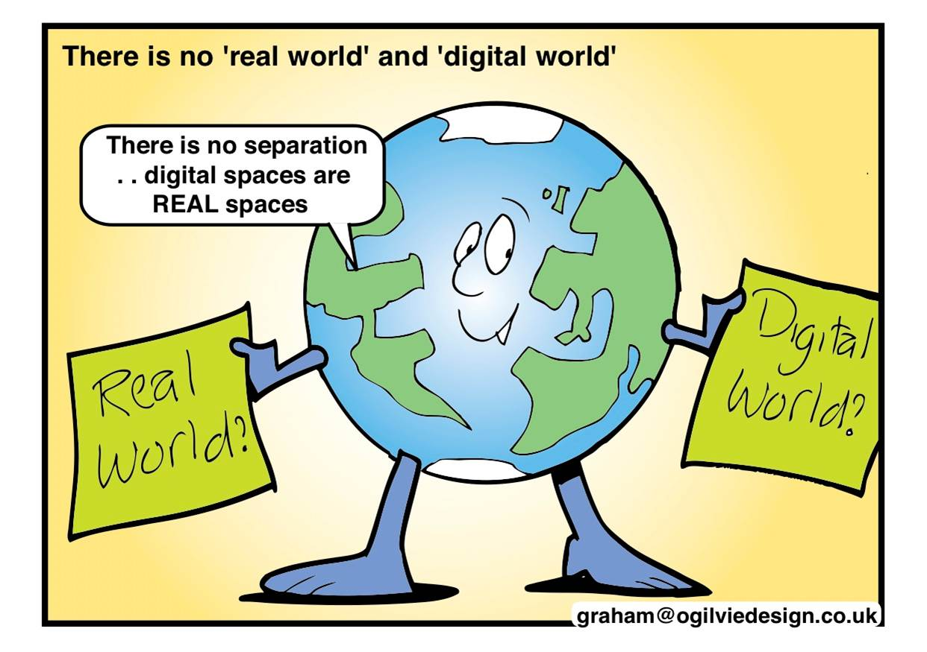
Importance of Online Safety
There is no separation between the real world and online
When you use the internet, you interact with real people
What goes on the web, stays on the web
Much of our life is now connected to the Internet, we need to protect our online presence.

Slide 5
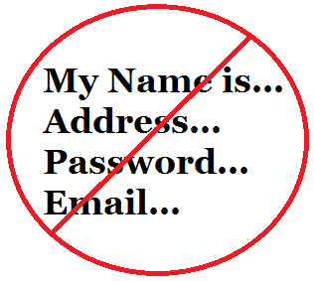
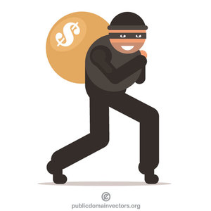
Online Behavior
Don’t say anything that you wouldn’t say to someone in person
Remember that you are talking to real people!
Don’t share personal information online, it spreads fast!
Full name, address, phone number, passwords, credit cards
Remember the law
Stealing music, videos, pictures online is just like shoplifting

Slide 6
Online Behavior (cont.)
Remember that people online may not appear to be who they claim, always be cautious
If you don’t know them in person, don’t meet them in person
Be careful who you trust

Slide 7
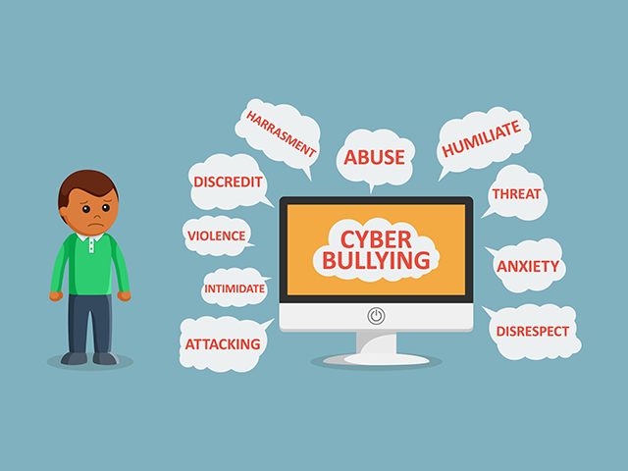
Cyber Bullying
Cyberbullying is bullying that takes place over digital devices like cell phones and computers
Cyberbullying includes sending, posting, or sharing negative, harmful, false, or mean content about someone else.
It can include sharing personal or private information about someone else causing embarrassment or humiliation.
Some cyberbullying crosses the line into unlawful or criminal behavior.

Slide 8
How to Handle Cyberbullying
Ignore/block the sender
Bullies want you to respond
Take a picture of the message
Keep records
If they will not leave you alone, tell an adult
If you are threatened or sent lewd images, tell an adult and report it to law enforcement

Slide 9
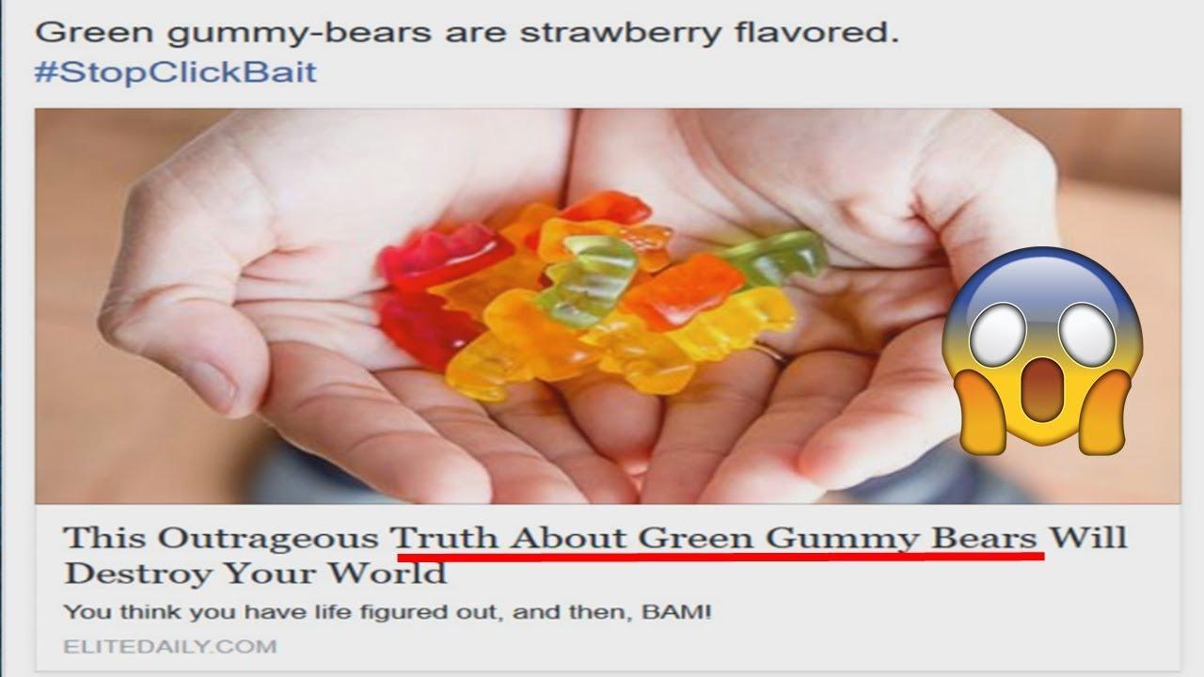
Other Internet Safety Tips
Don’t click the clickbait!
Ads or pictures that are setup in such a way that make you want to click them
They could lead you to malicious websites that can harm your computer (or phone)
Often times they are phishing scams

Slide 10
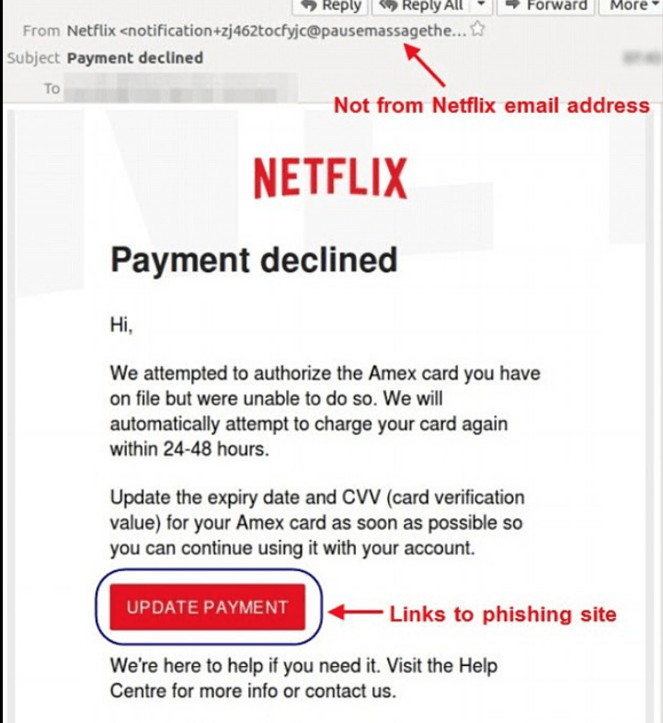
Other Internet Safety Tips (cont.)
Phishing
Emails, messages, or other communications that pretend to be official
They are trying to steal your information, such as passwords, credit cards, etc.

Slide 11
Other Internet Safety Tips (cont.)
Never share passwords, always log out!
If you do not log out of your accounts on computers that are used by other people, they can access your information or make changes to your accounts!
Use strong passwords, at least 8 characters long, with at least 1 capital letter, symbol, and number.

Slide 12
Conclusion
Treat your online interactions like in-person interactions
Ignore messages from cyberbullies, and tell a trusted adult if they won’t leave you alone
Be careful about what you click online, and make sure you protect your accounts by logging out

Slide 13
Any Questions?

